Slide 1
Case Study on buying the Body Accessories
Ayush Saxena​

Slide 2


Agenda
A
Introduction
Plan
Prepare and Process
Analyze with the help of Graphs
Steps to Plan and buy the Product
Share my idea to buy the Product
Act
Thank you

Slide 3
Introduction
In today’s era Fashion is a basic need of human lifestyle without fashion you are getting outdated, and maximum people running behind fashion without fashion society will be laid off as you are not part of society.
There are many brands that are competing in their segment but by this thing consumers got confused about which one is best among all varieties.
In this case study, we will have a budget in which we have to buy lifestyle products for our needs, and we will be discussing the best appeal product for us in all the segments.

Slide 4
Plan
The very first task is to decide what is needed for me and what to buy lifestyle products, so I decided to buy 2 pairs of jeans 1 shirt 1 pair of shoes and a body wash.
The second thing is that we have to analyze the company rating in all the segments which is best for jeans, shirts, shoes, and body wash.
After analyzing by asking friends and watching trends on the internet I will shortlist the brands and products of all the segments according to my budget.
And then I will visit the store and get them according to my choice and budget.

Slide 5
Prepare and Process
For Prepare I go with some of the data of my friends who have bought these things in recent months and collect all the data with them and summarize according to the category
In the Next slides, I summarized the data and formed a pivot table chart of trending sales figures of what my friends choose in this era.
After summarizing the data, I will move forward to buy the product of that segment.
With the help of my friend’s sales data, we will look forward to the graphs and analyze what we have to buy.

Slide 6
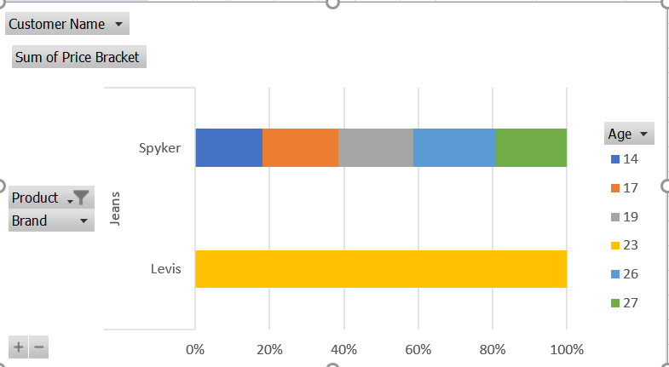
Jeans Sales Table Of Friends

Slide 7
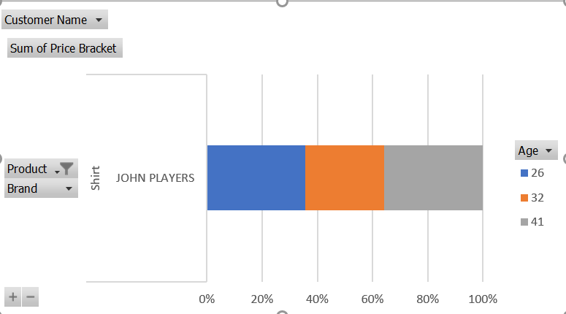
Shirt Sales Table Of Friends

Slide 8
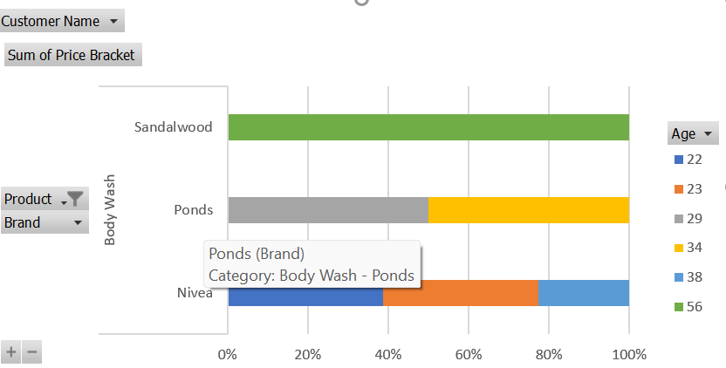
Body Wash Sales Table of friends

Slide 9
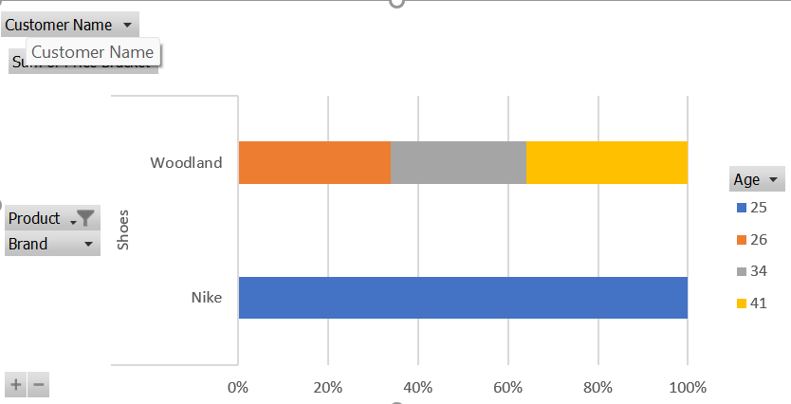
Shoes Sales Table Of Friends

Slide 10
All Segment Purchased items

Slide 11
Analyze Matrix of Product
S.No | Product | Max item Purchased | Color to be choose | Avg Price Bracket
1 | Jeans | Spyker | White/Black/Blue | 1500-2000
2 | Shirt | John Player | Black/Olive/Cream | 1500-2000
3 | Body-wash | Sandalwood | Rose/Whitening | 300-500
4 | Shoes | Nike | Jordan/sneakers | 2000-2500

Slide 12
Steps to Plan and buy the Product
As consider all the aspects now its turn to implement all the analysis by buying the products.
Planning to Buy Clothes
Planning to buy a Cream shirt and blue jeans as my color is whiteish and if I buy a dark color, it will not suit on me, so I decided to buy the light color clothes
Planning to buy the Shoes
As I am planning to buy the light color clothes and jeans and a shirt so I go for a funky sneakers
Planning to buy the Body Wash
Considering the all the aspects of my body I will prefer the light color accessories with dark sneakers it will look perfect on me
Go for buy the Product
Strategy
Coordinating with the analysis I would prefer for the whitening body wash for me

Slide 13
Share my Idea to Shopkeeper to buy the product
S
Clothes
I ask the Shopkeeper to show me the light color shirt and dark jeans according to my research he shows me a white shirt and black jeans which was a good outfit for me, and I bought it
Shoes and Body-Wash
I ask the shopkeeper to show me the funky sneakers according to my dress and he show me the White and Black combination sneakers that was funky and matching with my dress.
And as we have decided according to my requirement, I have bought the whiting body wash.

Slide 14
Timeline
Finalize the item that I must buy and go for shopping to buy that lifestyle product.
05 Dec 2022
Thinking to buy the products
06 Dec 2022
Analyze what to buy???
07 Dec 2022
Coordinate with my friends and research more about the fashion
08 Dec 2022
Analyze the data given by friends and research on the internet
09 Dec 2022

Slide 15
A Simple act and judgment will take you a long way in the future.
“
”
Ayush Saxena

Slide 16
Thank you
Ayush Saxena​
ayushsaxenamasai@gmail.com

